Slide 1
Lecture 8
Signals and Systems (ELL205)
By Dr. Abhishek Dixit
Dept. of Electrical Engineering
IIT Delhi

Slide 2
Outline of the Lecture
Introduction to Convolution

Slide 3
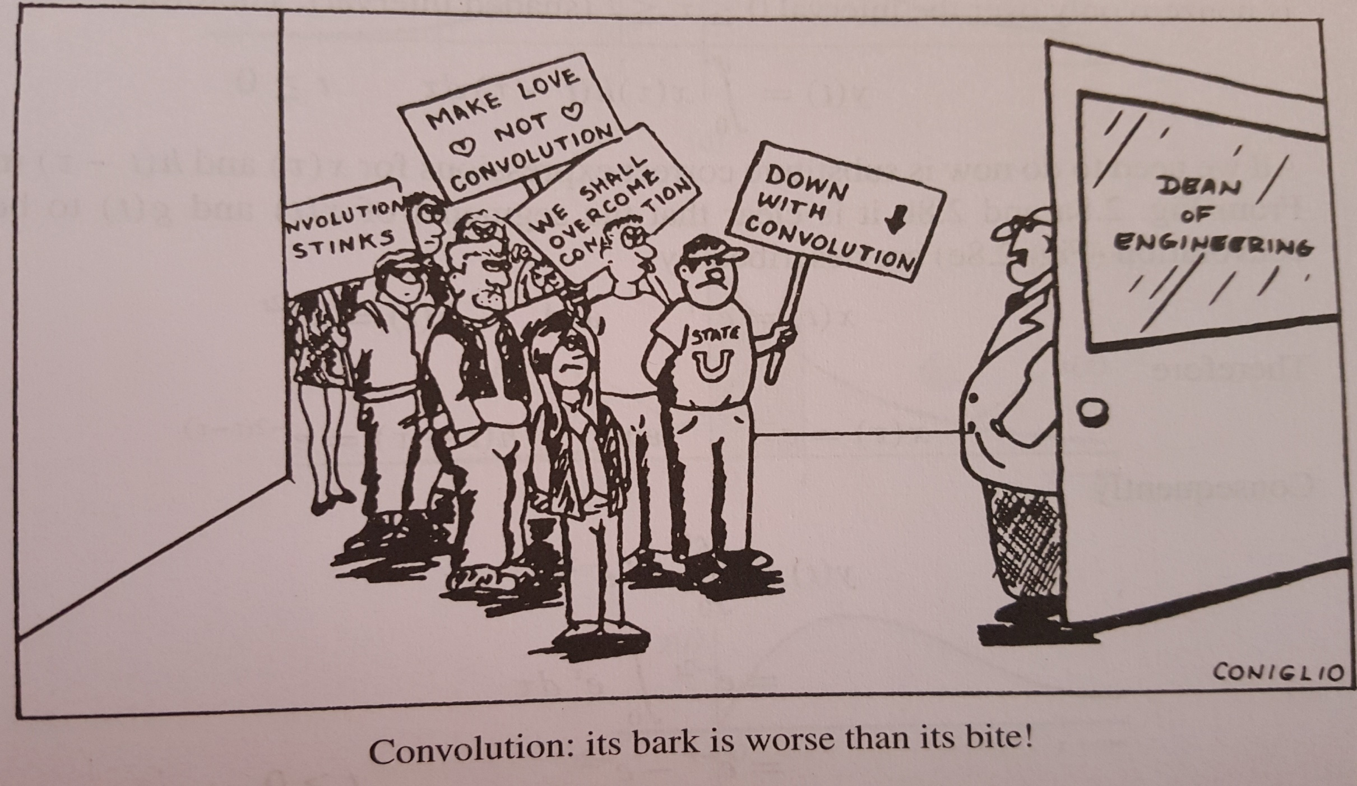
IEEE Spectrum, March 1991, p. 60: Convolution has driven many electrical engineering undergraduates to contemplate theology either for salvation or as an alternative career.

Slide 4
System properties
Memoryless
Invertibility
Causality
Stablity
Linearity
Time invariance
LTI (Linear Time Invariant)

Slide 5
Decomposition of a signal
Is there exists a better way of finding output of an LTI system for a given input ?
  Decompose an input signal into a linear combination of basic signals
  Response due to sum of inputs = Sum of response due to each inputs

Slide 6
Decomposition of a signal
Is there exists a better way of finding output of an LTI system for a given input ?
  Decompose an input signal into a linear combination of basic signals
  Response due to sum of inputs = Sum of response due to each inputs
Two kinds of basic signals:
  Delayed impulses Convolution
  Complex exponentials Fourier Series

Slide 7
How a signal can be decomposed into a linear combination of delayed impulses?
Weights
Delayed impulses

Slide 8



How decomposition helps?
Break input into additive parts and sum the responses to the parts.
$$x[n]$$
$$n$$

Slide 9





How decomposition helps?
Break input into additive parts and sum the responses to the parts.
$$x[n]$$
$$n$$
=
$$n$$
+
$$n$$
+
$$n$$
−1 0 1 2 3 4 5

Slide 10







How decomposition helps?
Break input into additive parts and sum the responses to the parts.
$$x[n]$$
$$n$$
$$y[n]$$
=
$$n$$
$$n$$
+
+
$$n$$
$$n$$
+
+
$$n$$
$$n$$
−1 0 1 2 3 4 5

Slide 11


How decomposition helps?
Break input into additive parts and sum the responses to the parts.
$$y[n]$$
$$x[n]$$
=
$$n$$
$$n$$
$$y[n]$$
=
$$n$$
$$n$$
+
+
$$n$$
$$n$$
+
+
$$n$$
$$n$$
−1 0 1 2 3 4 5

Slide 12
S
Time-invariance
S
Linearity & Time Invariance
S

Slide 13

S
This operation is referred to as convolution
Representing a system by a signal
Very powerful if you know the response of a system to any impulse, you can find response of the system to any input
Notation:
$$=\left(x∗h\right)[n]$$

Slide 14




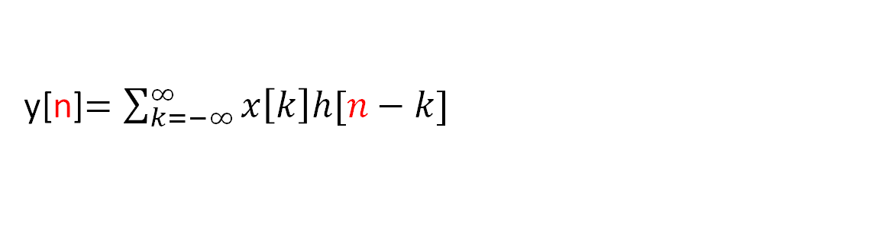
Convolution operation
y[n]$=\sum_{k=−∞}^{∞}{x\left[k\right]h[n−k]}$
$$x[n]$$
$$h[n]$$
∗
n
n
−2−1 0 1 2 3 4 5
−2−1 0 1 2 3 4 5

Slide 15
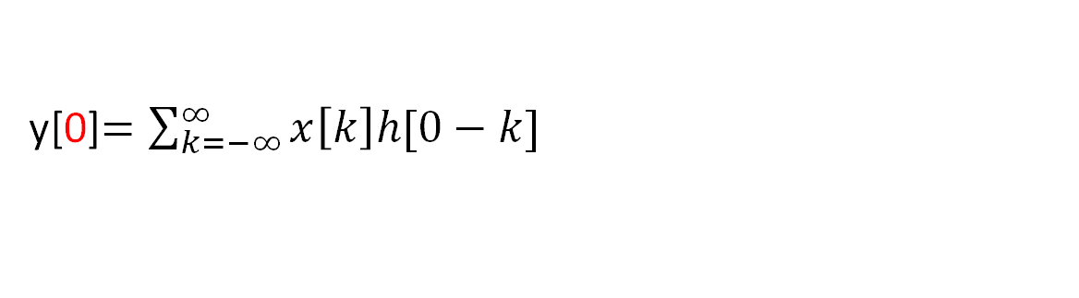
Convolution operation
y[0]$=\sum_{k=−∞}^{∞}{x\left[k\right]h[0−k]}$
$$x[n]$$
$$h[n]$$
∗
n
n
−2−1 0 1 2 3 4 5
−2−1 0 1 2 3 4 5

Slide 16



Convolution operation
y[0]$=\sum_{k=−∞}^{∞}{x\left[k\right]h[0−k]}$
$$x[k]$$
$$h[k]$$
∗
$$k$$
$$k$$
−2−1 0 1 2 3 4 5
−2−1 0 1 2 3 4 5

Slide 17




Convolution operation
y[0]$=\sum_{k=−∞}^{∞}{x\left[k\right]h[0−k]}$
$$x[k]$$
flip
∗
$$h[k]$$
k
k
$$h[−k]$$
k
−2−1 0 1
2 3 4 5

Slide 18

Convolution operation
y[0]$=\sum_{k=−∞}^{∞}{x\left[k\right]h[0−k]}$
$$x[k]$$
shift
∗
$$h[k]$$
k
k
$$h[0−k]$$
k
−2−1 0 1
2 3 4 5

Slide 19

Convolution operation
y[0]$=\sum_{k=−∞}^{∞}{x\left[k\right]h[0−k]}$
$$x[k]$$
∗
$$h[k]$$
k
k
$$h[0−k]$$
$$h[0−k]$$
k
k
−2−1 0 1
2 3 4 5

Slide 20


Convolution operation
y[0]$=\sum_{k=−∞}^{∞}{x\left[k\right]h[0−k]}$
$$x[k]$$
multiply
∗
$$h[k]$$
k
k
$$h[0−k]$$
$$h[0−k]$$
k
k
−2−1 0 1
2 3 4 5
$$x[k]h[0−k]$$
k
-2 -1 0 1 2 3 4 5

Slide 21
Convolution operation
y[0]$=\sum_{k=−∞}^{∞}{x\left[k\right]h[0−k]}$
$$x[k]$$
sum
∗
$$h[k]$$
k
k
$$h[0−k]$$
$$h[0−k]$$
k
k
−2−1 0 1
2 3 4 5
$$x[k]h[0−k]$$
∞
.
_{k=−∞}−2−1 0
k
= 1
1 2 3 4 5

Slide 22
Convolution operation
y[0]$=\sum_{k=−∞}^{∞}{x\left[k\right]h[0−k]}$
$$x[k]$$
$$h[k]$$
∗
k
k
$$h[0−k]$$
$$h[0−k]$$
k
k
−2−1 0 1
2 3 4 5
$$x[k]h[0−k]$$
∞
.
_{k=−∞}−2−1 0
k
= 1
1 2 3 4 5

Slide 23



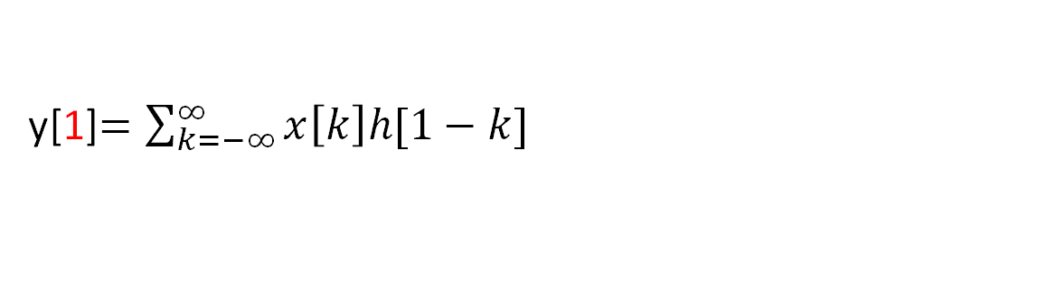


Convolution operation
y[1]$=\sum_{k=−∞}^{∞}{x\left[k\right]h[1−k]}$
$$x[k]$$
$$h[k]$$
∗
k
k
$$h[1−k]$$
$$h[1−k]$$
k
k
−2−1 0 1
2 3 4 5
$$x[k]h[1−k]$$
∞
.
_{k=−∞}−2−1 0
k
= 2
1 2 3 4 5

Slide 24




Convolution operation
y[2]$=\sum_{k=−∞}^{∞}{x\left[k\right]h[2−k]}$
$$x[k]$$
$$h[k]$$
∗
k
k
$$h[2−k]$$
$$h[2−k]$$
k
k
−2 −1 0 1
2 3 4 5
$$x[k]h[2−k]$$
∞
.
_{k=−∞}−2 −1 0
k
= 3
1 2 3 4 5

Slide 25



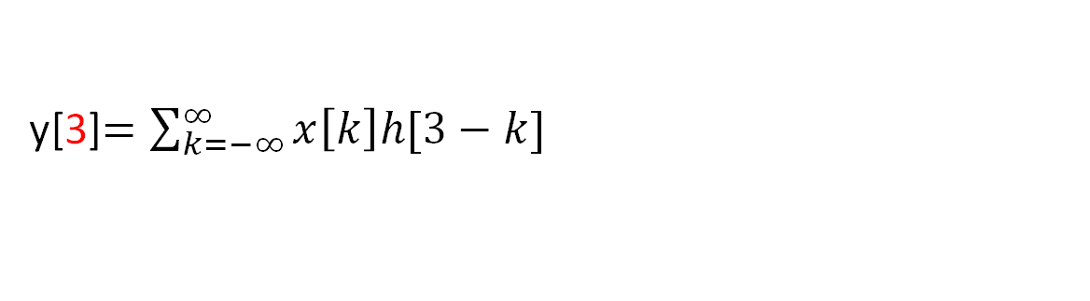


Convolution operation
y[3]$=\sum_{k=−∞}^{∞}{x\left[k\right]h[3−k]}$
$$x[k]$$
$$h[k]$$
∗
k
k
$$h[3−k]$$
$$h[3−k]$$
k
k
−2 −1 0 1
2 3 4 5
$$x[k]h[3−k]$$
∞
.
_{k=−∞}−2 −1 0
k
= 2
1 2 3 4 5

Slide 26



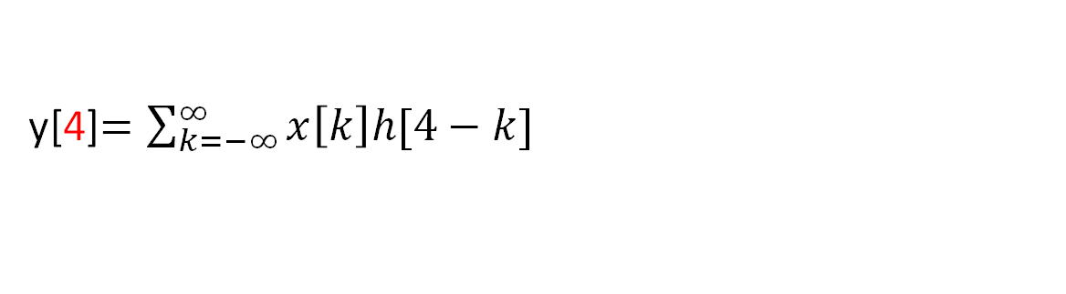


Convolution operation
y[4]$=\sum_{k=−∞}^{∞}{x\left[k\right]h[4−k]}$
$$x[k]$$
$$h[k]$$
∗
k
k
$$h[4−k]$$
$$h[4−k]$$
k
k
−2 −1 0 1
2 3 4 5
$$x[k]h[4−k]$$
∞
.
_{k=−∞}−2 −1 0
k
= 1
1 2 3 4 5

Slide 27






Convolution operation
y[5]$=\sum_{k=−∞}^{∞}{x\left[k\right]h[5−k]}$
$$x[k]$$
$$h[k]$$
∗
k
k
$$h[5−k]$$
$$h[5−k]$$
k
k
−2 −1 0 1
2 3 4 5
$$x[k]h[5−k]$$
∞
.
_{k=−∞}−2 −1 0
k
= 0
1 2 3 4 5

Slide 28
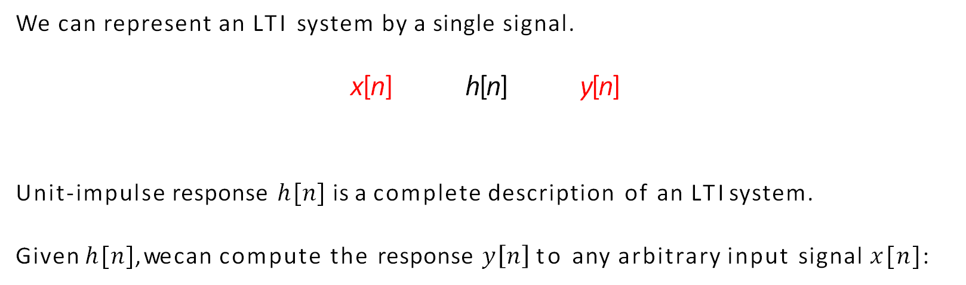
Summary of DT convolution
We can represent an LTI system by a single signal.
x[n] h[n] y[n]
Unit-impulse response $h[n]$ is a complete description of an LTI system.
Given $h[n]$, we can compute the response $y\left[n\right]$to any arbitrary input signal $x[n]$:

Slide 29
CT convolution
The same applies to CT signals
δ_{Δ}(t)
x(t)
1
∆
∆
t
t
As Δ → 0, kΔ → τ , Δ → dτ , and δ_{Δ}(t) → δ(t):

Slide 30
S
Time-invariance
S
S
LTI

Slide 31
Comparison of DT vs. CT

Slide 32




Convolution in DT
1
$$y\left[n\right]=({n+1)a}^{n}u[n]$$
2
$$y\left[n\right]=na^{n}u[n]$$
3
4
$$y\left[n\right]={na}^{n}$$
$$y\left[n\right]=({n+1)a}^{n}$$

Slide 33
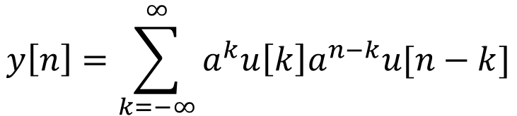
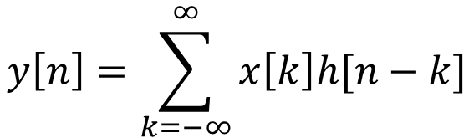

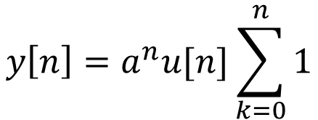
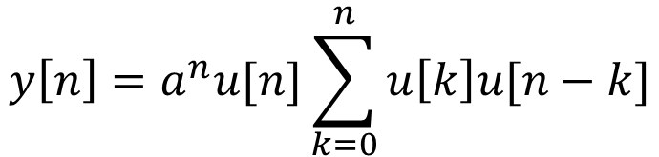
Convolution in DT
$$y\left[n\right]=\sum_{k=−∞}^{∞}{x\left[k\right]h[n−k]}$$
$$y\left[n\right]=\sum_{k=−∞}^{∞}{a^{k}u\left[k\right]a^{n−k}u[n−k]}$$
$$y\left[n\right]=a^{n}u[n]\sum_{k=0}^{n}{u\left[k\right]u[n−k]}$$
$$y\left[n\right]=a^{n}u[n]\sum_{k=0}^{n}{1}$$
$$y\left[n\right]=({n+1)a}^{n}u[n]$$

Slide 34
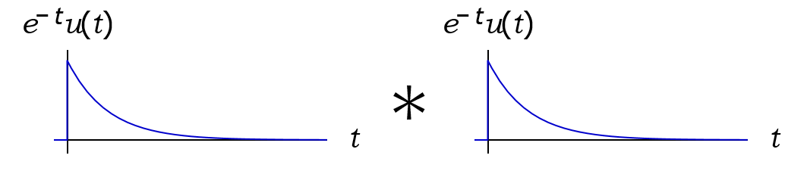
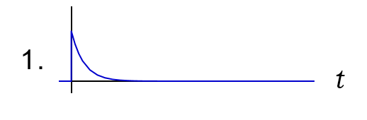
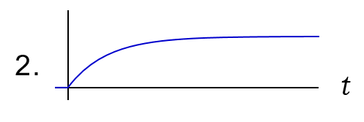
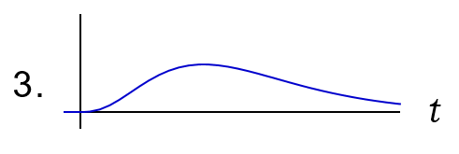
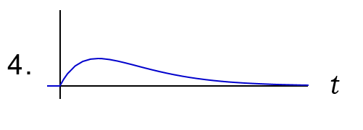
Which plot shows the results of the convolution below?

Slide 35
Which plot shows the results of the convolution below?
$$y\left(t\right)=\int_{−∞}^{∞}{e^{−τ}u\left(τ\right)e^{−\left(t−τ\right)}u\left(t−τ\right)dτ=u\left(t\right)\int_{0}^{t}{e^{−τ}u\left(τ\right)e^{−\left(t−τ\right)}u\left(t−τ\right)dτ=}}u\left(t\right)e^{−t}\int_{0}^{t}{u\left(τ\right)u\left(t−τ\right)dτ=t}u\left(t\right)e^{−t}$$

